Slide 2
Style Sheets
In this first lesson, Style Sheets, you will learn to:
  Define and describe style sheets.
  Define and describe cascading style sheets (CSS).
  Explain how to implement styles with CSS.
2

Slide 3
Need of Style Sheets 1-2
Style sheets are a set of rules that describe the appearance of data in an XML document.
XML was inspired by the problems posed by presentational markup. Presentational markup does not describe data; it defines the appearance of data. In a document, if you had to change all proper nouns from bold to italics, you would have to do it manually for each proper noun. Presentation markup failed to provide same look and feel across multiple devices such as computers, Personal Digital Assistant (PDA) devices, and cell phones.
Style sheets and XML solve these problems. XML describes data. Style sheets define the appearance of data. However, both XML and style sheets are defined in separate files.

Slide 4
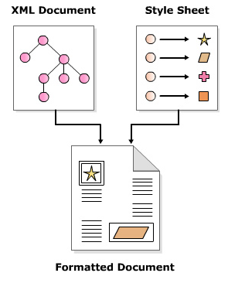
Need of Style Sheets 2-2
Figure depicts formatted document with style sheet.

Slide 5
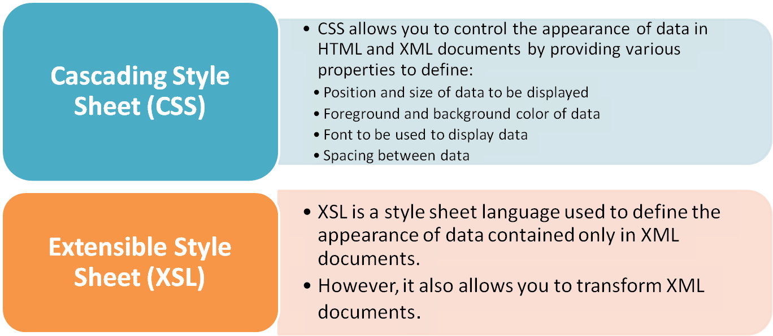
Various Style Sheets
There are several style sheets available. However, following two are the most popular style sheets:

Slide 6

Cascading Style Sheets 1-2
Cascading Style Sheets is a rule-based language invented in 1996 to write formatting instructions for data contained in HTML documents.
A CSS style sheet comprises a set of rules for various elements in a document.
Each rule defines how the data enclosed in the element should be displayed.
Style sheet rules can be combined from different sources, or subsets can be created or the rules can be overridden.
The term cascading is derived from this ability to mix and match rules.

Slide 7
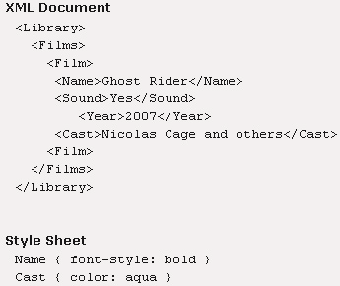
Cascading Style Sheets 2-2
Figure shows an example of Cascading Style Sheet.

Slide 8
Benefits of CSS
Benefits of Cascading Style Sheets:
  Any style or presentation changes to data can be achieved faster as changes are to be implemented in one place.
  Device independence can be achieved by defining different style sheets for different device. For example, you can have different style sheet for desktop computers, PDAs, and cell phones.
  Reduction in document code as the presentation information is stored in a different file and can be reused.

Slide 9

Style Rules 1-4
A style sheet in CSS comprises a set of style rules.
These rules define how the content enclosed in an element will be displayed.
These rules are applicable to all child elements within an element.
A style rule comprises a selector, a property, and a value.
A property and a value separated with a colon are referred to as property declaration.
Figure depicts the style rules.
selector
  selector is an element name of an XML document. A typical element name could be CD, Name, or Title.
property
  property is a CSS style property that defines how the element will be rendered. Some of the CSS properties are border, font, and color.
value
  Value is the value associated with a CSS property. One CSS property can have several values. The various values for property font-family are the various font family names such as ‘times’, ‘arial’, and ‘courier’ to name a few.

Slide 10
Style Rules 2-4
In Cascading Style Sheets (CSS), style rules can comprise more than one selector.
To include multiple selectors or group multiple selectors, one needs to provide a comma-separated list of element names.
The following code depicts a sample XML document containing information about endangered species.
Snippet
<?xml version="1.0" ?>
<Endangered_Species>
<Animal>
<Name language="English">Tiger</Name>
<Threat>poachers</Threat>
<Weight>500 pounds</Weight>
</Animal>
</Endangered_Species>

Slide 11
Style Rules 3-4
The following code demonstrates an ideal way to define style rules by displaying each element on a separate row.
However, these three style rules can be converted to a single style rule by grouping the selectors as demonstrated in the following code.
Snippet
Name { display: block }
Threat { display: block }
Weight { display: block }
Snippet
Name, Threat, Weight { display: block }

Slide 12
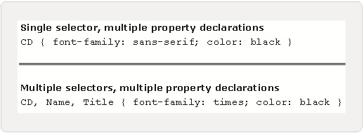
Style Rules 4-4
A single selector can have more than one property-value pairs associated with it.
For example, the figure shows a CD element having two property declarations – one to set the font family to sans-serif, and other to set the color of text to black.
Notice the property-value pairs are separated by a semi-colon.
Similarly, a collection of one or more property-value pairs can be associated with more than one selector.
For example, the figure shows two property declarations assigned to three elements namely, CD, Title, and Name.

Slide 13
External Style Sheets 1-2
In CSS, the style rules are written in a file with the extension .css.
This file is associated with an XML document using a style sheet processing instruction.
A few points to note about style sheet processing instruction are:
  It should appear in the prolog section of an XML document, that is, it should appear before any tag of an element.
  One XML document can have more than one style sheet processing instructions, each linked to one .css file.
where,
  xml-stylesheet is the processing instruction.
  url is the URL of a .css file which can be on a local system or anywhere on the Internet.
  type="text/css" is optional; however if a browser does not support CSS, it informs the browser that it does not have to download a .css file.
Syntax
<?xml-stylesheet href="url" [type="text/css"]?>

Slide 14
External Style Sheets 2-2
The following XML code demonstrates an example of an external style sheet.
Here the style rules are defined in a file named headers.css.
Snippet
<?xml-stylesheet href="headers.css" type="text/css"?>

Slide 15
Selectors in CSS
In this second lesson, Selectors in CSS, you will learn to:
  Identify simple selectors in CSS.
  State the use of universal selector in CSS.
  Describe ID selectors.

Slide 16
Simple Selectors
Simple selector comprises an element name followed by one or more property declarations.
Same property declarations can be assigned to multiple elements by separating element names with a comma.
Simple selectors match every occurrence of the element in a document.
The following code demonstrates an example of simple selector.
Snippet
/* Simple selector */
CD { color: black }
/* Single element, multiple property declarations */
CD { color: white; background-color: blue }
/* Multiple elements, multiple property declarations */
CD, Name, Title { color: white; background-color: blue }

Slide 17
Universal Selector
A universal selector comprises an asterisk followed by property declarations.
It is used when you want to assign the same style rules to all the elements in a document.
A universal selector matches all the elements in a document.
The following code displays the content of all elements in a document in blue.
Snippet
* { color : blue }

Slide 18
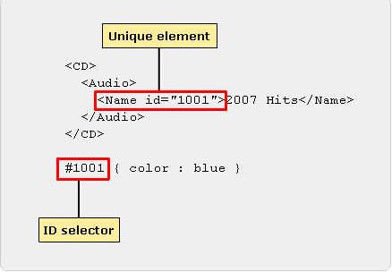
ID Selector 1-3
An ID selector comprises a hash (#) symbol, immediately followed by an attribute's value followed by property declarations.
It is used to define styles for unique elements in a document.
For example, if you want the data of a unique element to be in a different style, you would define an ID selector for it.
Unique element is one which has one of its attributes named as id as shown in figure.

Slide 19
ID Selector 2-3
Syntax
#attribute_value { property_declarations }
Snippet
#1001 { color : blue }

Slide 20





ID Selector 3-3
ID selectors are used to emphasize the data contained in unique elements in an XML document.
However, not all browsers support ID selectors.
A browser has to read the Document Type Definition (DTD) to identify which attributes have an ID type. Browsers such as Safari, Mozilla, and Netscape do not read external DTD subsets.
Opera lacks the ability to read internal DTDs as well. Hence, these browsers may not apply the style rules involving ID selectors.
Internet Explorer does support ID selectors as it reads external DTDs.

Slide 21
Properties and Values
In this third lesson, Properties and Values, you will learn to:
  State and describe how to use color properties.
  Describe the font property.
  Describe the other properties such as margins, borders, and padding.
  Explain briefly about positioning and alignment.

Slide 22
Color Properties 1-2
CSS provides properties to set the foreground and background color of text.
CSS uses color name, red-green-blue (RGB) values, RGB percentages, and hexadecimal values to specify color values.
The various ways in which color values are specified is shown:
Color Names | RGB Percentages | RGB Values | Hexadecimal Values
aqua | rgb(0%,65%,65) | rgb(0,160,160) | #00a0a0
black | rgb(0%,0%,0%) | rgb(0,0,0) | #000000
blue | rgb(0%,32%,100) | rgb(0,80,255) | #0050ff
gray | rgb(65%,65%,65%) | rgb(160,160,160) | #a0a0a0
green | rgb(0%,100%,0%) | rgb(0,255,0) | #00ff00
lime | rgb(0%,65%,0%) | rgb(0,160,0) | #00a000
maroon | rgb(70%,0%,32%) | rgb(176,0,80) | #b00050
navy | rgb(0%,0%,65%) | rgb(0,0,160) | #0000a0
olive | rgb(65%,65%,0%) | rgb(160,160,0) | #a0a000
purple | rgb(65%,0%,65%) | rgb(160,0,160) | #a000a0
red | rgb(100%,0%,32%) | rgb(255,0,80) | #ff0050
silver | rgb(90%,90%,90%) | rgb(225,225,255) | #d0d0d0
teal | rgb(0%,65%,100%) | rgb(0,160,255) | #00a0ff
white | rgb(100%,100%,100%) | rgb(255,255,255) | #ffffff
yellow | rgb(100%,100%,0%) | rgb(255,255,0) | #ffff00

Slide 23
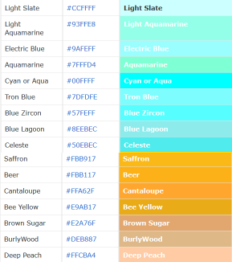

Color Properties 2-2

Slide 24

Setting Color Properties 1-2
The CSS specification provides the properties color and background-color to set the foreground and background color of text enclosed in elements.
Figure depicts the syntax for setting properties.
where,
  color: Property to set the foreground color of text in an element.
  colorValue: colorValue can take up any value from the CSS color table.
  background-color: Property to set the background color of text in an element.

Slide 25
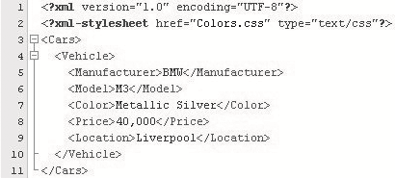
Setting Color Properties 2-2
Figure shows the XML code for style rules defined in Colors.css file.
Figure depicts the style sheet for Colors.css file.
where,
  Cars { background-color: rgb(0%,32%,100%); color: #ffffff }: Causes the text enclosed in Cars element to be displayed in white color with a background color of blue.
  Price { color: yellow; }: Causes the text enclosed in Price element to be displayed in yellow color.
The output is shown in figure.

Slide 26




Font Properties
The CSS specification defines several font properties to set the font family, font size, font style such as bold, italics, and so forth.
Some of these properties are listed in the table.
Property Name | Description
font-family | To specify the font family
font-size | To specify the size of font
font-style | To specify the style of font
font-weight | To specify the weight of font

Slide 27
font-family Property 1-2
The font-family property is used to specify the name of the font family to be applied to an element.
Figure shows the syntax for font-family property.
where,
  font-family: Property to specify the font-family to be used.
  font-family name(s): Comma separated list of font-family names such as serif, san-serif, monospace, cursive, and fantasy. The list should start with the most specific font in which you want to display the data and end with the most generic font.

Slide 28
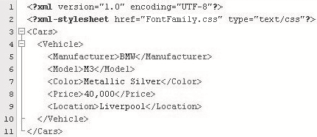

font-family Property 2-2
Figure shows the code for style rules stored in FontFamily.css file.
Figure depicts the style sheet for FontFamily.css file.
The output is shown in figure.

Slide 29

font-size Property 1-3
The font-size property is used to specify the size of font used to display element data.
Figure shows the syntax for font-size property.
where,
  font-size: Property to specify the size of font.
  xx-small | x-small | small | medium | large | x-large | xx-large: One of various values that can be assigned to the property font-size.

Slide 30
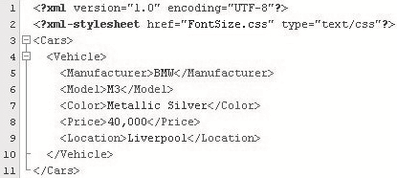
font-size Property 2-3
Figure shows the code for style rules defined in FontSize.css file.

Slide 31
font-size Property 3-3
Figure depicts the style sheet for FontSize.css file.
where,
  Cars { font-size: medium }: All the text enclosed in Cars element and its child elements will be displayed with medium font size.
The text enclosed in the element Cars will be displayed in either Arial, Times, or Serif font.
The rule becomes applicable to all the elements enclosed in Cars element.
If the system does not support Arial font, then Times will be selected; if Times is not supported then, Serif will be selected.
The output is shown in figure.

Slide 32

Font Style and Weight Properties 1-3
CSS provides two properties namely, font-style and font-weight to add emphasis or meaning to parts of data.
Figure shows the syntax for font style and weight properties.
where,
  font-style: Property to specify the style of text in an element.
  normal | oblique | italic: One of the values that can be assigned to font-style property.
  font-weight: Property to specify the weight style of the text in an element.
  light | normal | bold: One of the values that can be assigned to font-weight property.

Slide 33
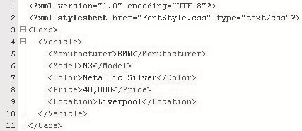
Font Style and Weight Properties 2-3
Figure shows the code for style rules defined in FontStyle.css file.

Slide 34

Font Style and Weight Properties 3-3
Figure depicts part of the style sheet for fontstyle.css file.
where,
  Manufacturer { font-weight: bold }: The text enclosed in Manufacturer element will be displayed in bold.
  Location { font-style: italic }: The text enclosed in Location element will be displayed in italics.
The output is shown in figure.
where,
  BMW: Text is displayed in bold
  Liverpool: Text is displayed in italics

Slide 35
Margins in CSS 1-3
Every element in an XML document is displayed in its own box.
CSS provides four properties namely,
margin-left, margin-right, margin-top, and
margin-bottom to insert space around the element's box.
Figure shows the syntax for margins in CSS.
where,
  margin-left | margin-right | margin-top | margin-bottom: The various margin properties to set left, right, top and bottom margins.
  marginValue: The value to be assigned to one of the margin properties. This value can be a fixed value or a percentage.

Slide 36
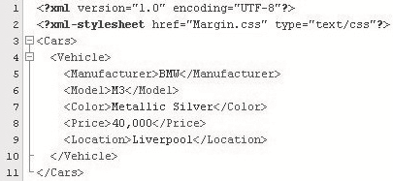
Margins in CSS 2-3
Figure shows the code for style rules defined in Margin.css file.

Slide 37

Margins in CSS 3-3
Figure depicts the style sheet for Margin.css file.
where,
  Manufacturer { margin-left: 20; margin-right: 50; }: Inserts a space of 20 pixels to the left and a space of 50 pixels to the right of text enclosed in element Manufacturer.
  Manufacturer { background-color: aqua }: Sets the background of text enclosed in element Manufacturer to aqua.
  Vehicle { background-color: orange }: Sets the background of text enclosed in element Vehicle to orange.

Slide 38
Border Properties in CSS 1-4
Borders are rectangular outlines surrounding an element's box.
CSS provides properties to create dotted, solid, and groove borders to name a few.
Figure shows the syntax for border properties.
where,
  border: Property to set the border of the box surrounding an element's data.
  border_width: Specifies the thickness of the border. Possible values are thin, medium, and thick.
  border_style: Specifies the style of the border. Possible values are solid, dashed, dotted, groove, ridge, double, inset, and outset.
  border_color: Specifies the color of the border. All values that are applicable to CSS color property are allowed.

Slide 39
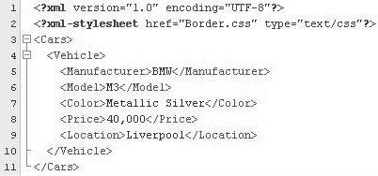
Border Properties in CSS 2-4
Figure shows the code for style rules defined in Border.css file.

Slide 40

Border Properties in CSS 3-4
Figure depicts the style sheet for Border.css file.
where,
  Manufacturer {border: thick dashed magenta }: Displays a thick and dashed magenta border around the content of Manufacturer element.
  Model { border: thick solid olive }: Displays a thick and solid olive border around the content of Model element.
  Color { border: thick groove aqua }: Displays a thick and groove aqua border around the content of Color element.
  Price { border: thick inset gray }: Displays a thick and inset gray border around the content of Price element.

Slide 41

Border Properties in CSS 4-4
The output is shown in figure.
where,
  BMW has thick dashed magenta border
  M3 has thick solid olive border
  Metallic Silver has thick groove aqua border
  40,000 has thick inset gray border

Slide 42
Padding Properties in CSS 1-4
The border property surrounds the text in an element with an outline.
To insert space between the border and the text of an element, CSS provides the padding property.
Figure shows the syntax for padding property.
where,
  padding: Property specifying padding between the text and border of an element.
  padding_width: Composite value that can have maximum four values in the following order: top, right, bottom, and left. These values are followed by length unit designators. However, default is pixel unit.

Slide 43
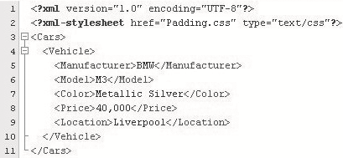
Padding Properties in CSS 2-4
Figure shows the XML code for style rules defined in Padding.css file.

Slide 44
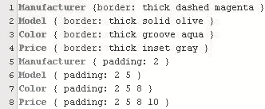
Padding Properties in CSS 3-4
Figure depicts the style sheet for Padding.css file.
where,
  Manufacturer { padding: 2 }: Inserts padding of 2 pixels between the four borders and text of Manufacturer element. The four borders applicable are top, right, bottom, and left.
  Model { padding: 2 5 }: Inserts padding between the borders and text of Model element. The value 2 is applied to top and bottom borders and 5 is applied to left and right borders.
  Color { padding: 2 5 8 }: Inserts padding between the borders and text of Color element. The value 2 is applied to top border, 5 to left and right borders, and value 8 to bottom border.
  Price { padding: 2 5 8 10 }: Inserts padding between the borders and text of Price element. The value 2 is applied to top border, 5 to right border, 8 to bottom border, and 10 to left border.

Slide 45

Padding Properties in CSS 4-4
The output is shown in figure.

Slide 46
CSS Units
The values assigned to CSS properties are expressed in length units.
The table describes these units.
Unit Type | Unit Designator
Relative | em – defines the height of element’s font. ex – defines the x-height of element’s font. px – defines the pixel relative to display device. % - percentage.
Absolute | in – inches cm – centimeters mm – millimeters pt – 1/72 inch pc – 12 pt

Slide 47
Position Properties
Every element's text is placed in a box of its own.
The table lists the CSS positioning properties to position the text inside the box.
Note that the properties top, left, bottom, and right are used only if value of position property is not static.
Property | Description | Possible Values
position | Property to place an element in a static, relative, absolute, or fixed position | static, fixed, relative, or absolute
top | Property specifying how far the top edge of an element is above/below the top edge of the parent element | auto, integer, or floating point values adhering to CSS length units
left | Property specifying how far the left edge of an element is to the right/left of the left edge of the parent element | auto, integer, or floating point values adhering to CSS length units
bottom | Property specifying how far the bottom edge of an element is above/below the bottom edge of the parent element | auto, integer, or floating point values adhering to CSS length units
right | Property specifying how far the right edge of an element is to the left/right of the right edge of the parent element | auto, integer, or floating point values adhering to CSS length units

Slide 48

Position Properties Example 1-2
Consider an example based on positioning properties of CSS.
Figure shows the code for style rules defined in Position.css file.

Slide 49

Position Properties Example 2-2
Figure depicts the style sheet for Position.css file.
where,
  Location { position: relative; top:20; left :20 }: Positions the text of Location element relative to the previous element. However, inside the box, the content is placed at 20 pixels from top and 20 pixels from left.
  Price { position: absolute; top:40; left :20 }: Positions the text of Price element at an absolute location of 40 pixels from the top and 20 pixels from the left.
  The output is shown in figure.
where,
  40,000: Text displayed using absolute positioning
  Liverpool: Text displayed using relative positioning

Slide 50

Display Property 1-3
In HTML, if you wanted the text to appear as new paragraph, you would use the <P> tag.
The same can be achieved in XML by using CSS display property.
Figure shows the syntax for display property.
where,
  display: Property to specify how the element is to be rendered.
  none: No rendering is applied to the element.
  inline : Displays the element text as inline. This is the default value if no value is specified.
  block: Displays the element text on a new line in a block of its own.

Slide 51
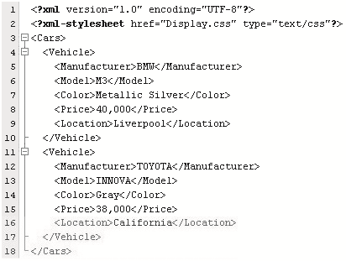
Display Property 2-3
Figure shows the XML code for style rules defined in Display.css.
Figure depicts part of the style sheet in the Display.css file.
where,
  Price { display: block }: Inserts a new line before and after the text of element Price.

Slide 52
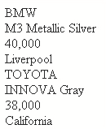
Display Property 3-3
The output is shown in figure.
Data in each element is displayed on a separate row in block of its own.

Slide 53

Text Alignment and Indentation 1-4
The display:block property renders the text of an element in a separate block.
Inside this block, you can align and indent the text using the CSS properties text-align and text-indent properties respectively.
Figure shows the syntax for text alignment and indentation.
where,
  text-align: Property to align the text in a block.
  alignment_value: Can be one of the following: left (default), right, center, and justify.
  text-indent: Property to indent the text in a block.
  value: Floating point value followed by absolute units designators or relative units designators; or an integer value followed by percentage (%) symbol.

Slide 54
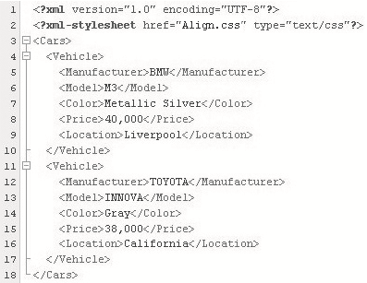
Text Alignment and Indentation 2-4
Figure shows the code for style rules defined in Align.css.

Slide 55

Text Alignment and Indentation 3-4
The figure depicts the style sheet for Align.css file.
where,
  Price { display: block }: Inserts a new line before and after the text of element Price and displays the text in a separate block.
  Price { text-align: left }: Left aligns the text of Price element.
  Price { text-indent: 20 }: Indents the text of Price element at 20 pixels.

Slide 56

Text Alignment and Indentation 4-4
The output is shown in figure.
As observed, the text in element Price is displayed on a separate row and left indented at 20 pixels.

Slide 57
Inheritance and Cascades in CSS
In this last lesson, Inheritance and Cascades in CSS, you will learn to:
  Define the process of cascading.
  Explain inheritance.

Slide 58
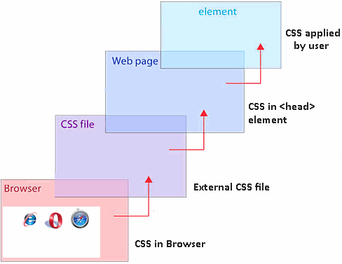

Cascading in CSS 1-5
There are several ways in which style sheets can be defined.
For example, one document can have more than one style sheet defined for it.
A browser has its own style sheet.
In such cases, it is possible that more than one style rule may exist for an element.
Hence, the W3C defines some rules to determine what style to apply to an element.

Slide 59
Cascading in CSS 2-5
The sorting of style rules begins with rule number 1.
If the style rule matches rule number 1, then the search is over; otherwise the search continues with rule number 2 and so on.
  Find all property declarations for an element in question. Apply the style rules if the element name matches the element in the selector. If there is no style rule defined for an element, the element inherits the style rules defined for the parent element. However, if the parent element does not have any style rules defined, then the element is rendered with default values.
  Style rules declared as important are considered next. A style rule can be declared important in the following manner:
Threat { display: block ! important }
  Important property declarations have a higher precedence over normal property declarations.

Slide 60
Cascading in CSS 3-5
Next, the origin of style sheet is determined. A style sheet can have the following sources:
  Author: The author of the XML document can define a style sheet in an external document to format the XML document.
  User/Reader: The end-user viewing the XML document can specify his/her personal style sheet to be used to format the XML document.
  User-agent: The browser is referred to as user-agent. A browser has its own default style sheet.
  The style rules defined in the author's style sheet override the style rules defined in the user's style sheet. The author's and the user's style sheet both override the user-agent's style sheet.

Slide 61
Cascading in CSS 4-5
Next, the specificity of a selector is determined in that a more specific selector will override the general selector.
  The specificity is determined by carrying out the following three activities:
    Count the number of ID attributes in the selector.
    Count the number of class attributes in a selector.
    Count the number of element names in the selector.

Slide 62
Cascading in CSS 5-5
Next, write the three numbers with no commas or spaces and in the same sequence as shown earlier.
  Higher the number, higher is the specificity.
  Rules with higher specificity override the ones with lower specificity.
  For example, following is a list of selectors sorted by specificity:
If two rules have the same weight, then the one specified last wins.
#favorite {...} /* a=1;b=0;c=0; specificity = 100 */
Name, CD, Artist.caps {...} /* a=0;b=1;c=3; specificity = 013 */
Artist.caps {...} /* a=0;b=0;c=1; specificity = 001 */

Slide 63

Inheritance in CSS 1-2
Ability of one entity to acquire the characteristics of another entity.
In CSS, the child elements inherit the styles rules defined for parent element.
Applicable only if the child has no explicit style rule defined for it, otherwise, the style rule defined for child element overrides the style rule defined for parent element.

Slide 64
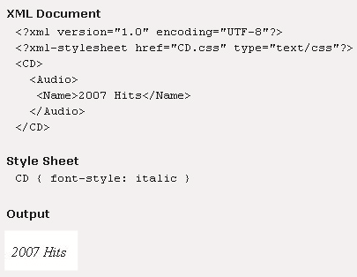
Inheritance in CSS 2-2
Figure shows that the text in element Name is displayed in italics.
This is because there are no style rules defined for elements Audio and Name.
Hence, the style rule defined for CD is inherited by child element Name.

Slide 65
Summary
In this module, Style Sheets, you learnt about:
  Style Sheets
    Style Sheets are a set of rules that define the appearance of data. These rules are written in a file with the extension .css. The .css file is associated with an XML document using the xml-processing instruction.
  Selectors in CSS
    Selectors define the elements to which the styles will be applied. The various types of selectors are simple, universal, and ID selectors.
  Properties and Values
    CSS provides several properties to define the appearance of data. Some of these properties are color, background-color, position, padding, font, and text-align to name a few.
  Inheritance and Cascades in CSS
    In CSS, a child element inherits the styles rules applied to its ancestor element. Also, there are several sources of style sheets, hence CSS follows W3C defined cascading order when applying style rules to elements.

